Slide 1


Text Clustering: Discovering Hidden Patterns in Text Data
Done By:
Ashfaq Hussain
Nandhu Krishna

Slide 2




1. Agenda
1
Introduction to Text Clustering
2
Text Preprocessing
3
Text Representation
4
Clustering Algorithms
5
Evaluation Metrics
6
Applications & Case Study
7
Summary & Future Scope

Slide 3

2. What is Text Clustering?
Text clustering is a machine learning technique that groups similar text documents automatically. It falls under unsupervised learning (no labeled data). Each cluster represents a topic or theme shared by documents. For example, grouping articles about sports, technology, or health.

Slide 4






3. Why Text Clustering Matters
1
2
Helps organize massive text data automatically.
Useful for discovering hidden topics and trends.
3
4
Reduces manual effort in text categorization.
Commonly used in search engines, social media, and customer analysis.

Slide 5

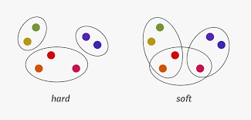

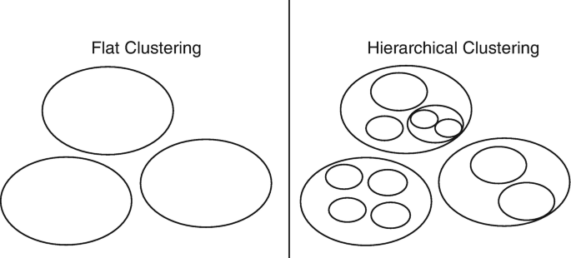
4. Types of Clustering
Hard Clustering
Soft Clustering
Each document belongs to exactly one cluster (e.g., K-means).
A document can belong to multiple clusters (e.g., LDA).
Flat Clustering
Hierarchical Clustering
No hierarchy; all clusters are on the same level.
Builds a tree-like structure of clusters.

Slide 6
5. How Can Text Clustering Be Performed?
The main steps include:
Text Preprocessing
Feature Extraction
Dimensionality Reduction
Clustering Algorithms
Clustering Evaluation

Slide 7




6. Text Preprocessing
1
2
Convert text to lowercase.
Remove punctuation, numbers, special symbols.
3
4
Remove stopwords (like “the”, “is”, “and”).
Tokenize sentences into words or phrases.
Example:
Raw: “The movie was AMAZING!!!”
Cleaned: “movie amazing”

Slide 8


6. Text Preprocessing
Lemmatization: Converts words to their base form (e.g., “running” → “run”).
Stemming: Removes suffixes (e.g., “connected” → “connect”).
Normalization ensures consistent vocabulary across documents.

Slide 9

7. Example of Preprocessing
Original Sentence:
“Data Scientists analyze data to extract meaningful insights.”
After Preprocessing:
“data scientist analyze extract meaningful insight”
This reduces noise and focuses on the core semantic content.

Slide 10

8. Feature Extraction - Bag of Words (BoW)
Represents text as a collection of word counts.
Ignores word order and context.
Simple but effective for small datasets.
Example:
Word | Frequency
data | 2
science | 1
machine | 1

Slide 11



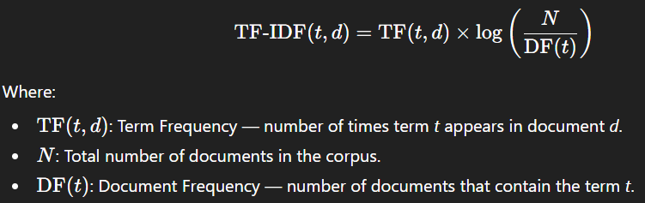
8. Feature Extraction- TF-IDF (Term Frequency – Inverse Document Frequency)
1
Weighs words based on their importance across documents.
2
Common words get lower weight; rare but meaningful words get higher weight.
3
Helps differentiate between “important” and “common” terms.
Formula:

Slide 12


8. Word and Sentence Embeddings
Represent text in dense vector space where similar words are close together.
Examples: Word2Vec, GloVe, FastText, BERT.
Capture semantic meaning and context.
Enable clustering based on meaning, not just frequency.

Slide 13
9. Dimensionality Reduction
Used to handle high-dimensional & noisy text features before clustering.
Diminishing the number of dimensions can be done through principal component analysis or using t-distributed stochastic neighbor embedding (t-SNE) to preserve the most essential information.
PCA: Linear method using eigenvalues/eigenvectors of covariance matrix.
t-SNE: Non-linear, preserves local structure via probability distributions.

Slide 14




10. Clustering Algorithms
1
2
K-means
Hierarchical
Partition-based, simple, widely used.
Tree-like grouping.
3
4
DBSCAN
LDA
Density-based, detects noise.
Probabilistic topic modeling for text.
Each has different strengths depending on dataset and goal.

Slide 15



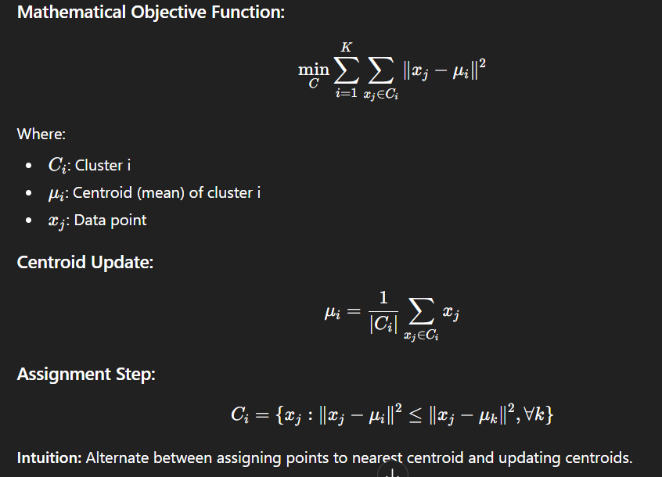
11.1. K-Means Clustering
Divides data into K clusters based on similarity.
Algorithm:
• Choose K cluster centers.
• Assign documents to nearest center.
• Recalculate centers and repeat.
Works well with TF-IDF vectors.

Slide 16

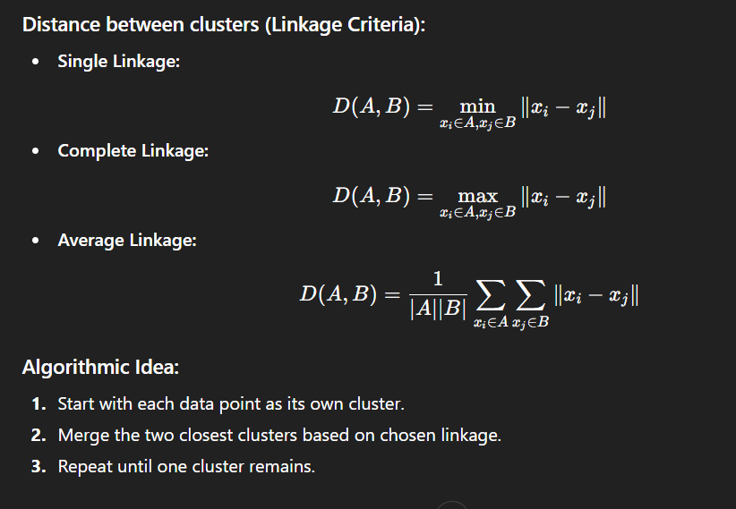






11.2. Hierarchical Clustering
1
2
Builds a dendrogram (tree) of nested clusters.
Can be agglomerative (bottom-up) or divisive (top-down).
3
4
Doesn’t require specifying K beforehand.
Useful for exploring cluster relationships.

Slide 17
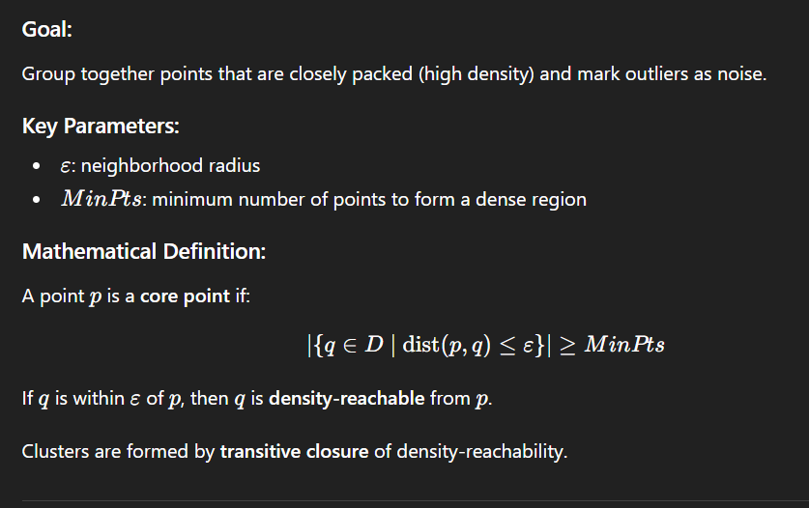

11.3. DBSCAN – Density Based

Slide 18
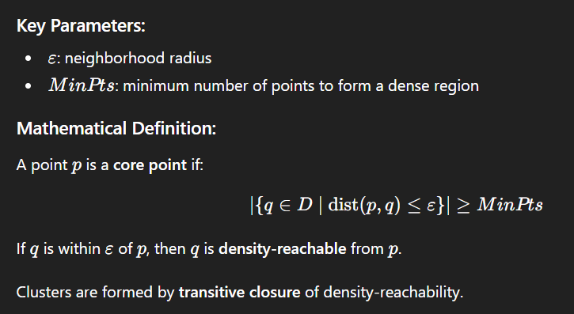
11.4. Topic Modeling (LDA)
Latent Dirichlet Allocation (LDA) groups documents by topics. Each document is a mix of topics; each topic is a mix of words. This helps interpret text clusters as topics rather than arbitrary groups.
Example:
Topic 1 → “match, goal, team” (Sports)
Topic 2 → “election, party, vote” (Politics)

Slide 19



12. Evaluation Metrics
Internal Metrics:
1
Silhouette Score
A measure that calculates how much an item resembles its own cluster relative to other clusters.
2
Davies–Bouldin Index
This is used to find out the average similarity ratio between each cluster and the one that is most similar..
3
Adjusted Rand Index (ARI)
It compares how much two different clusterings are alike in terms of class labels they assign to individual objects .
External Metrics:
Purity, NMI (Normalized Mutual Information) – compare to known labels.
Challenge: Often no “true” labels exist in unsupervised tasks.

Slide 20
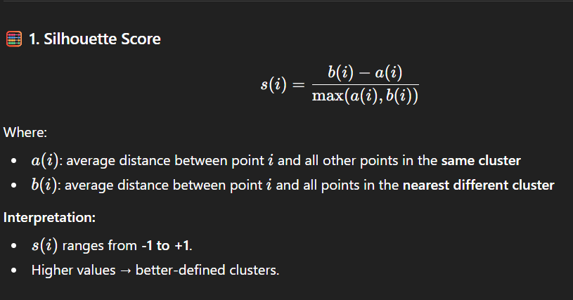
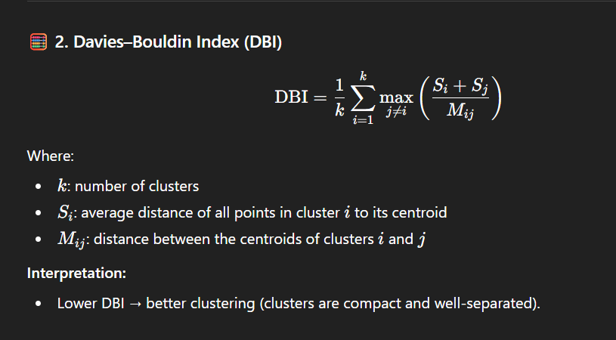
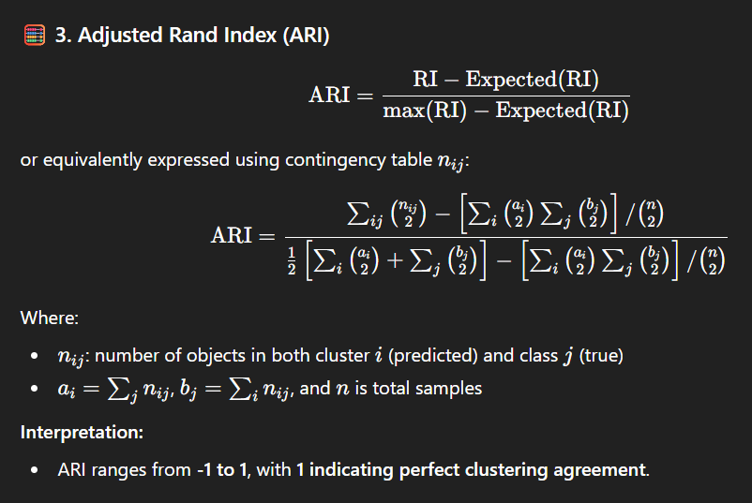

Slide 21
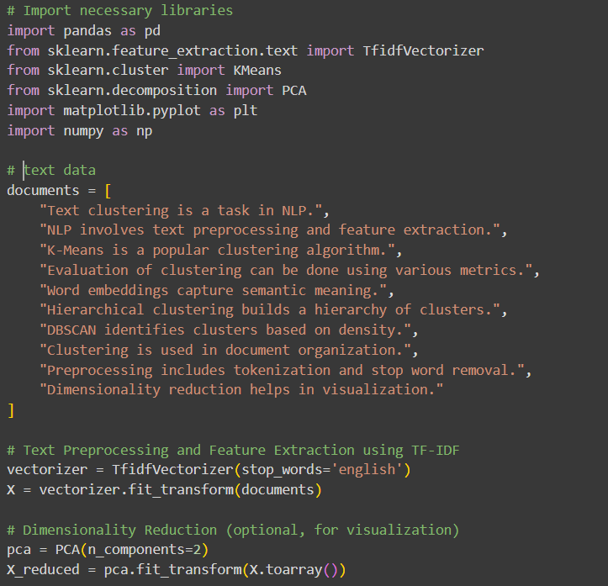
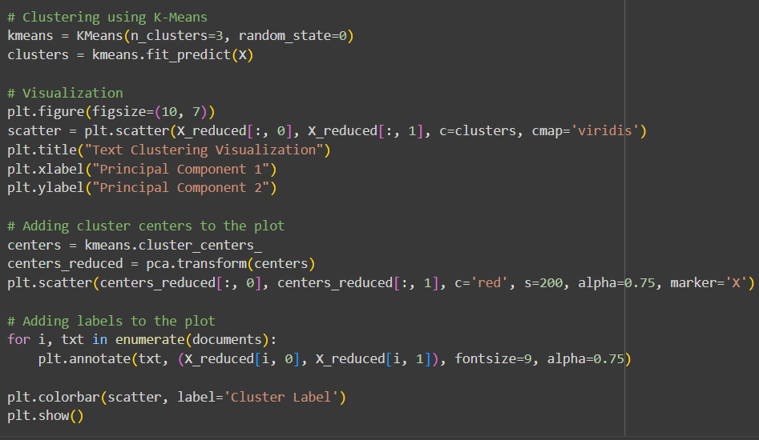
13. Sample Code and Visualization

Slide 22
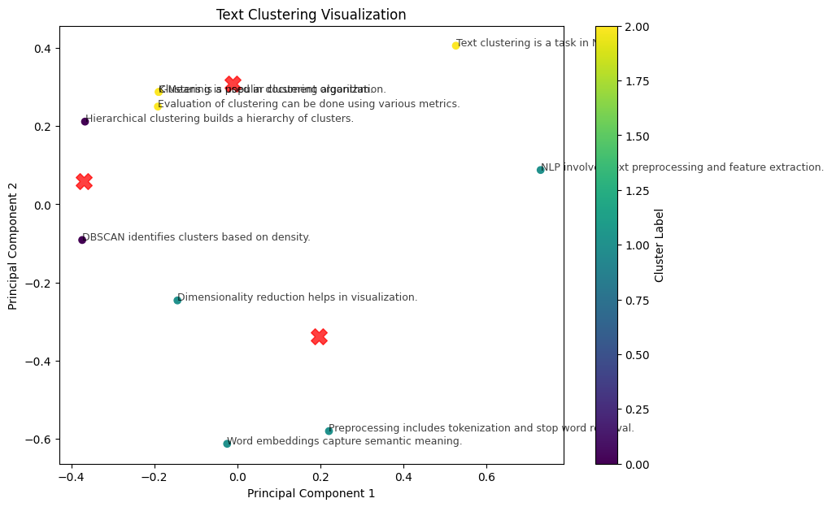

Slide 23

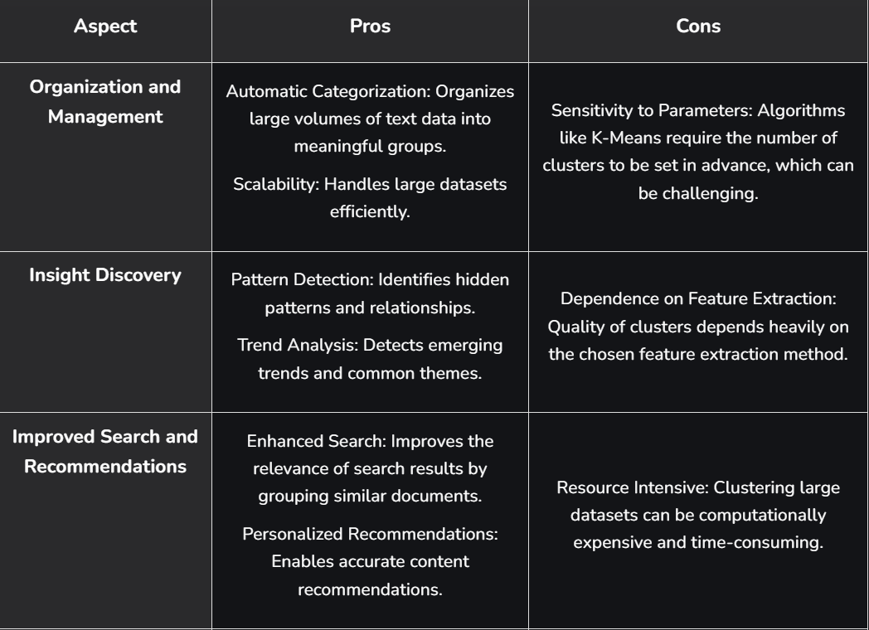
14. Pros and Cons

Slide 24



15. Real-World Applications
1
News Categorization
2
Social Media Monitoring
Group articles by topics.
Discover trending themes.
3
Customer Feedback Analysis
4
Research & Academia
Cluster reviews or complaints.
Topic discovery in papers.

Slide 25
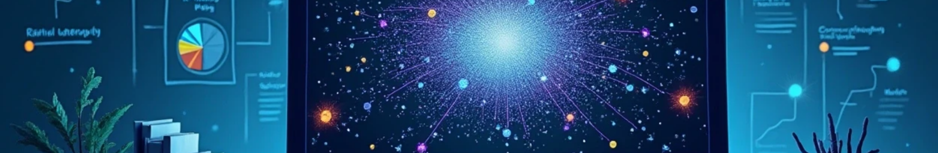


16. Summary & Future Scope
✅ Key Takeaways:
1
2
3
Text clustering = organizing unstructured text into meaningful groups.
Techniques: Preprocessing → Representation → Clustering → Evaluation.
Algorithms like K-means, LDA, and Hierarchical are widely used.
🚀 Future Scope:
1
2
3
Deep contextual embeddings (BERT, GPT).
Hybrid methods combining clustering + supervised learning.
Real-time text clustering in big data environments.

Slide 26

Thank You

